Slide 1

Course code : CSE3009 Course title : No SQL Data Bases Module : 5 Topic : 4
Column-store internals

Slide 2
Objectives
This session will give the knowledge about
Late Materialization
Joins

Slide 3
Late Materialization
In a particular query plan, various tables are accessed. The process of accessing several columns to create a record is known as tuple creation.
Creation of tuples based on the information present in the query plan is known as materialization.
In a query plan tuple is created if the join condition is satisfied.
The process where the tuples (where join condition is satisfied) are stitched together as soon as possible during a query plan is known as Early materialization

Slide 4
Late Materialization
The process where the tuples are not created until some part of the query plan is processed (apart from the checking of the join condition) is termed as Late Materialization.
It generally is the operation specified in the WHERE condition of a query.
This process is useful because it saves the CPU from performing operation of joining the unnecessary tuples

Slide 5
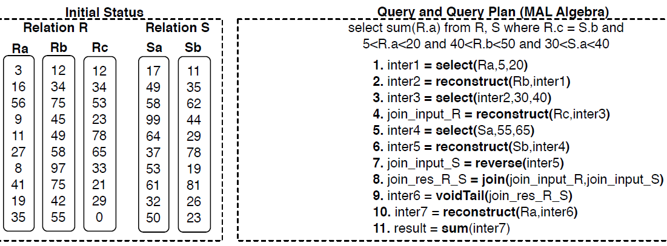
Late Materialization
Select sum(R.a) from R, S where R.c = S.b and 5<R.a<20 and 40<R.b<50 and 30<S.a<40

Slide 6
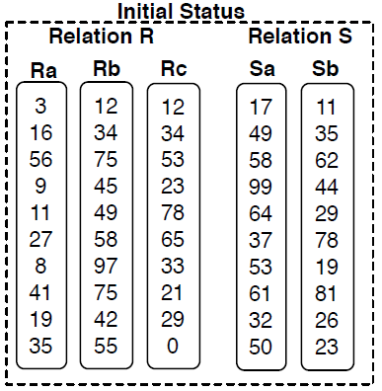
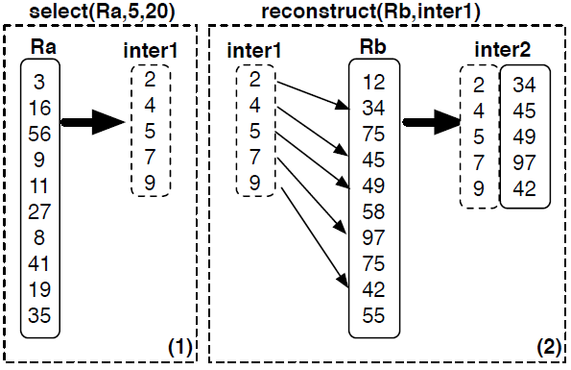
Late Materialization

Slide 7
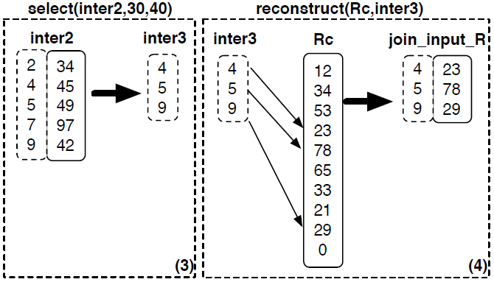
Late Materialization

Slide 8
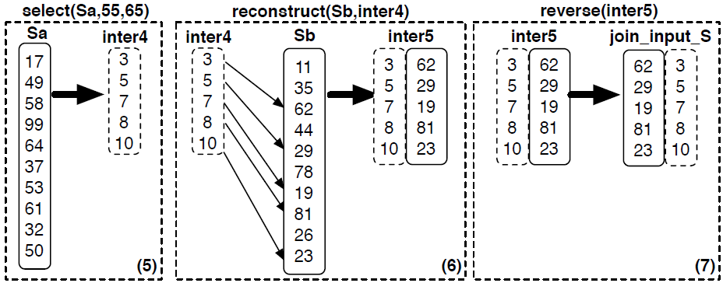
Late Materialization

Slide 9
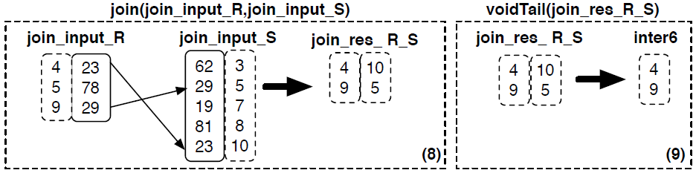
Late Materialization

Slide 10
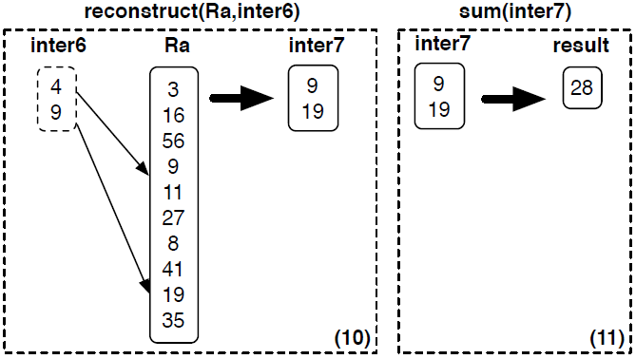
Late Materialization

Slide 11
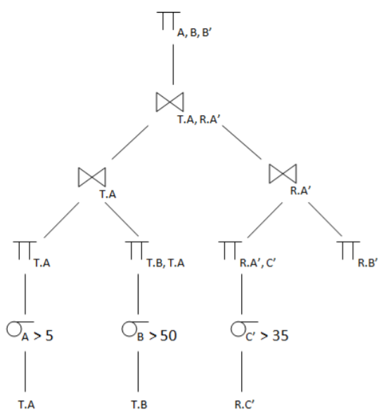
Late Materialization
Executing the following query which includes two table T,R
Query 1:SELECT T.A,T.B,R.B’ FROM T JOIN R ON (T.A=R.A’) WHERE A>5 AND B<50 AND C’<35

Slide 12
Joins
If an early materialization strategy is used relative to a join, tuples have already been constructed before reaching the join operator, so the join functions as it would in a standard row-store system and outputs tuples.
An alternative algorithm can be used with a late materialization strategy, however. In this case, only the columns that compose the join predicate are input to the join.
The output of the join is a set of pairs of positions in the two input relations for which the predicate succeeded.

Slide 13
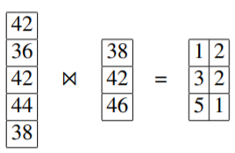
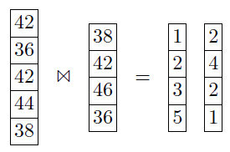
Joins
Example:
For many join algorithms, the output positions for the left (outer) input relation will be sorted while the output positions of the right (inner) input relation will not.
This is because the positions in the left column are usually iterated through in order, while the right relation is probed for join predicate matches.

Slide 14
Joins
Consider,
SELECT emp.age, dept.name FROM emp, dept WHERE emp.dept_id = dept.id
Unsorted positional output is problematic since typically after the join, other columns from the joined tables will be needed.
Unordered positional lookups are problematic since extracting values from a column in this unordered fashion requires jumping around storage for each position, causing significant slowdown.

Slide 15

Jive join
When we joined the column of size with a column of size 4 above, we received the following positional output:
The list of positions for the right (inner) table is out of order.
Let’s assume that we want to extract the customer name attribute from the inner table according to this list of positions, which contains the following four customers.

Slide 16

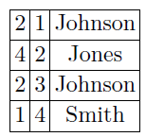
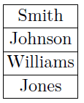

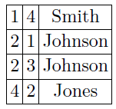
Jive join
The basic idea of the Jive join is to add an additional column to the list of positions that we want to extract, that is a densely increasing sequence of integers:

Slide 17
Group-By
Group-by is typically a hash-table based operation in modern column-stores and thus it exploits similar properties as discussed in the join section.
In particular, we may create a compact hash table, i.e., where only the grouped attribute can be used, leading in better access patterns when probing.

Slide 18
Aggregation
Aggregation operations make heavy use of the columnar layout.
In particular, they can work on only the relevant column with tight for-loops.
For example, assume sum(), min(), max(), avg() operators; such an operator only needs to scan the relevant column (or intermediate result which is also in a columnar form), maximizing the utilization of memory bandwidth.
An example is shown in Figure at Slide 5 in Step 11, where we see that the sum operator may access only the relevant data in a columnar form.

Slide 19
Arithmetic Operations
Other operators that may be used in the select clause in an SQL query, i.e., math operators (such as +,-*,/) also exploit the columnar layout to perform those actions efficiently.
However, in these cases, because such operators typically need to operate on groups of columns,
e.g., select A+B+C From R ...,
they typically have to materialize intermediate results for each action.

Slide 20
Inserts/updates/deletes
A natural approach to implement the write-store is to store differences (inserts, deletes, and updates) in an in-memory structure.
MonetDB uses plain columns, i.e., for every base column in the schema there are two auxiliary columns to store pending inserts and pending deletes; an update is a delete followed by an insert.
C-Store proposed that the write optimized store could also use a row-format which speeds up updates even more as only one I/O is needed to write a single new row (but merging of updates in the column format becomes potentially more expensive).

Slide 21
Inserts/updates/deletes
The VectorWise system uses a novel data structure, called Positional Delta Trees (PDTs) to store differences.
The key advantage is that merging is based on knowledge of the position where differences apply, and not on the sort key of the table, which can be composite and complex.

Slide 22
Summary
This session will give the knowledge about
Late Materialization
Joins

